Slide 1
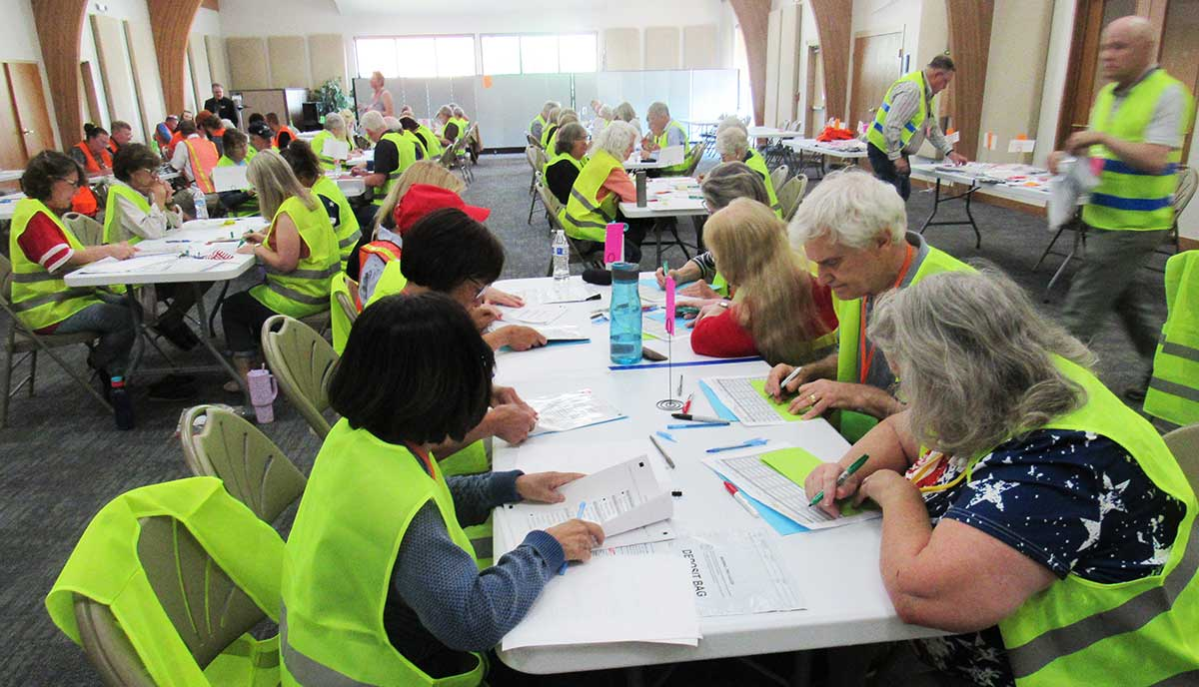
Rocky Mountain Method
Advanced
Hand Count Training

Slide 2
Advanced Topics
Extra Position: Expediter
Second-Level Aggregation
Chain of custody
  Ballot box to batching
  Batching to tallying
  Tallying to aggregation
  Aggregation to handoff
Special situations
  Spoiled ballots
  Overvotes
  Undervotes
  Write-ins
Reconciliation
  Handover at close of polls
  Reconciliation after batching
  Spoiled ballots
  Final reconciliation
  Handoff

Slide 3
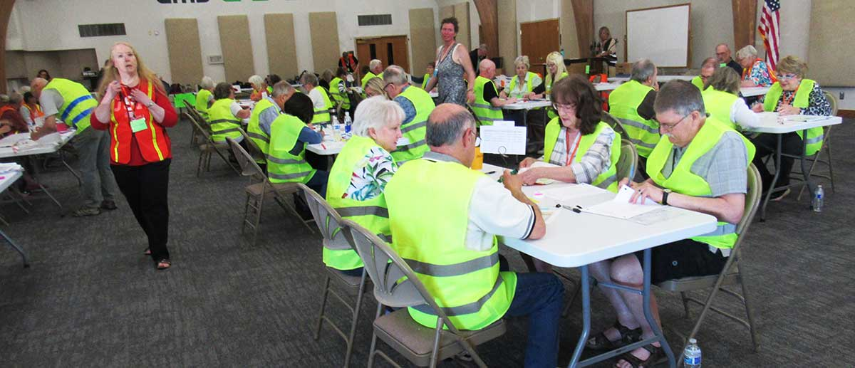
Extra Position: Expediter
Optional, helpful with 2 or more tally teams
Solve problems before they start
Answer questions, pass on messages, keep things moving
Also known as floor manager
Notes:
In a precinct expecting less than 100 ballots, this position is not necessary. In a bigger precinct, having knowledgeable team leaders may be all you need. But if you have 3 or more tally teams, it’s going to be helpful to have one person who is very familiar with the process and has general knowledge of elections, to answer questions, rearrange people into the most needed positions, initial any corrections, and deal with any disturbances, so the counters can keep counting.

Slide 4
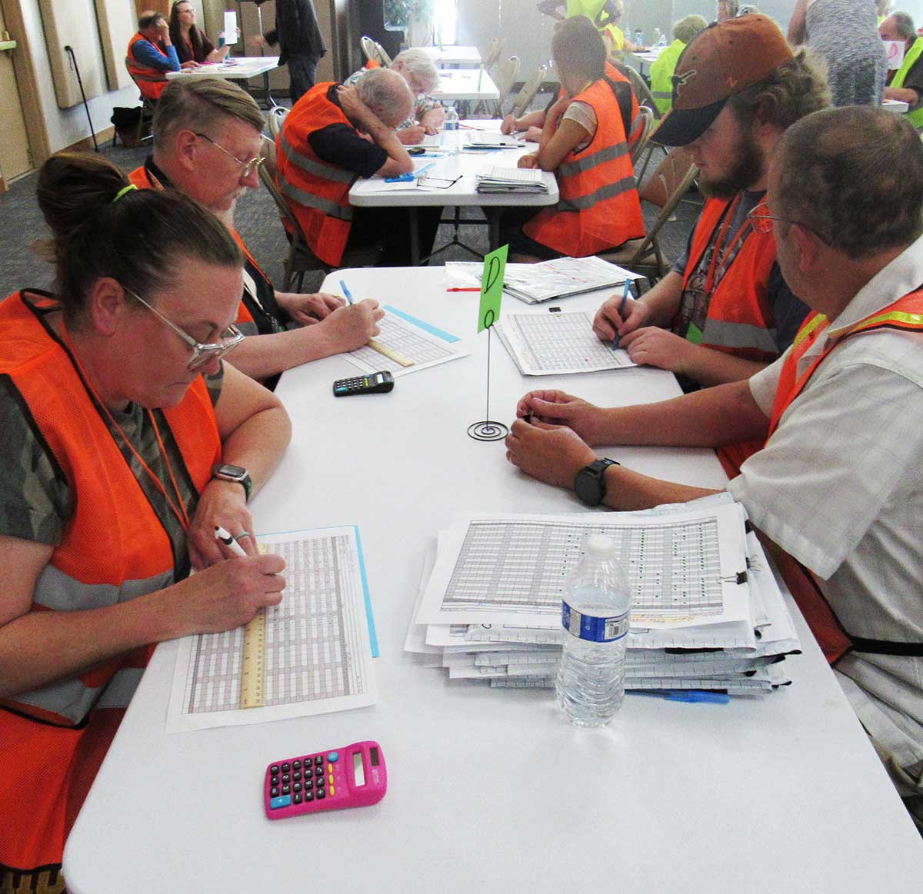
Second-Level Aggregation
If counting more than about 600 ballots
Like first-level aggregation, but using the first-level aggregation sheets instead of batch tally sheets.
No need for third-level aggregation within a precinct
Notes:
A 25x25 aggregation sheet can handle up to 625 ballots, which is an average amount to expect in a precinct for a general election. For a slightly larger number of ballots, the aggregation sheet could be expanded to 30 or 40 rows. When readability becomes a problem, total the rest of the batches on a second (or more) set of aggregation sheets.
The aggregation team then does a second level of aggregation to get the final totals. Second-level aggregation is like first-level aggregation but you enter first-level aggregation information instead of batch information.
Since second-level aggregation can handle up to somewhere around 15,000 ballots, there should be no need for higher levels of aggregation – or rather, the higher levels of aggregation happen at the city or county level as precincts call in their information.

Slide 5
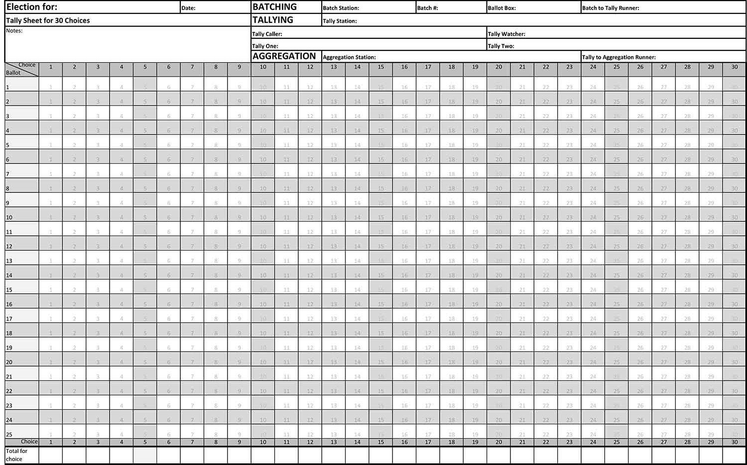
Chain of Custody
Chain of custody: tracking ballots through the process and creating a record of everyone who handled those ballots
Check chain of custody information at every step!
Notes:
Chain of custody is a guard against anyone adding or taking out ballots. If the number of ballots at the end doesn’t match the number at the beginning, a good chain of custody points to who had an opportunity to do anything to the ballots, making it easier to find out what happened because you know where to start looking.
Chain of custody is like asking someone who is looking for their keys, “Where did you last have the keys? Who did you give them to?”
All those boxes to fill out can look intimidating to a new hand counter, so help the team understand it is nothing more than a record of whose hands the ballots passed through on their way. Also, it is easy to get excited about tallying ballots as fast as possible, so keep the team disciplined about never accepting custody of a batch before checking that all chain of custody information up to that point is correctly filled out.

Slide 6
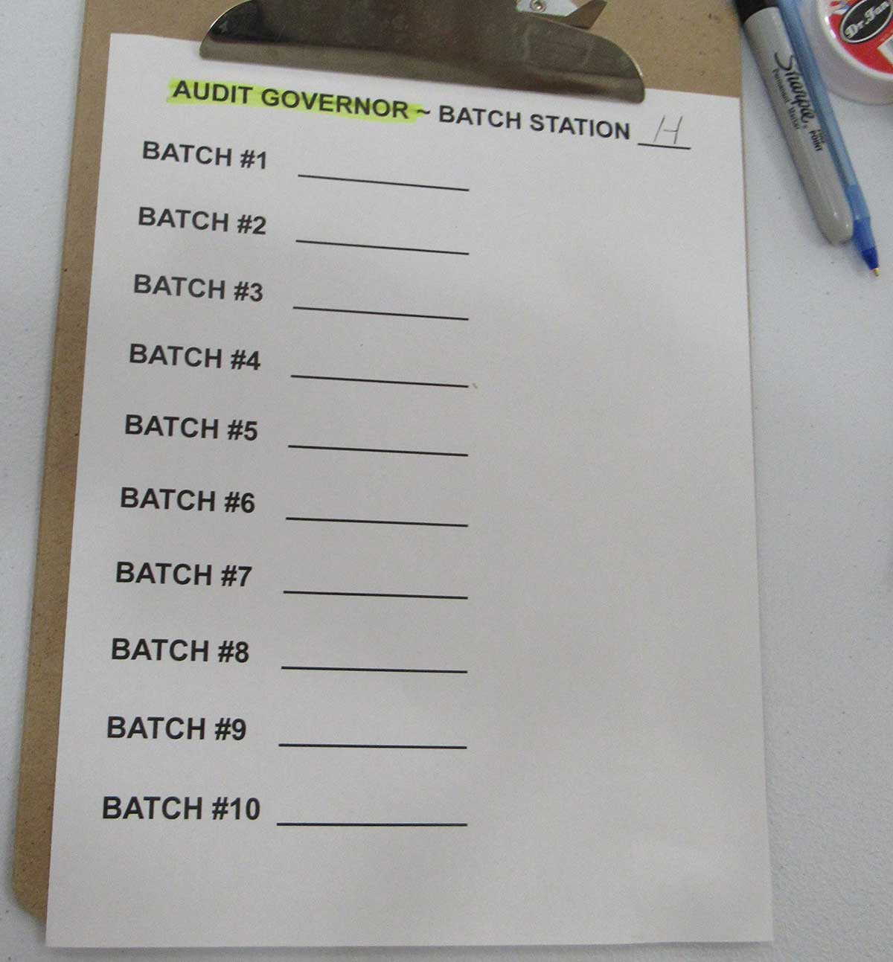
Chain of Custody: Ballot Box to Batching
Each batch has a unique combination of numbers tracking it through the process
Record the number of ballots on the batch number list.
Record on BOTH tally sheets and ballot bag.
  Ballot box #
  Batch team #
  Batch #
Notes:
The first thing we do with ballots in the Rocky Mountain Method is divide them into batches of 25 or fewer. With a few exceptions such as spoiled ballots, those ballots stay in that batch all the way through the process and have a unique combination of numbers to track them. A team of four counting 53 ballots in one precinct won’t have much trouble keeping track of the batches, but the more ballots and the more tally teams, the more critical to record these numbers.
Each batching team and each ballot box has a letter or a number assigned to it (if there is only one, the number is 1 and it might not need to be tracked.) The batch number could refer to the number of batches from the ballot box, or the number of batches the batch team has handled; either system works as long as batch teams are clear which way to handle it and the same system is used for all batches.
When a batching team finishes counting out a batch, they record the number of ballots in the batch on their batch number list. Then they record the batch information on the top of BOTH tally sheets and (if instructed) the ballot bag. The batch is not ready for tallying until all this information is filled out.

Slide 7
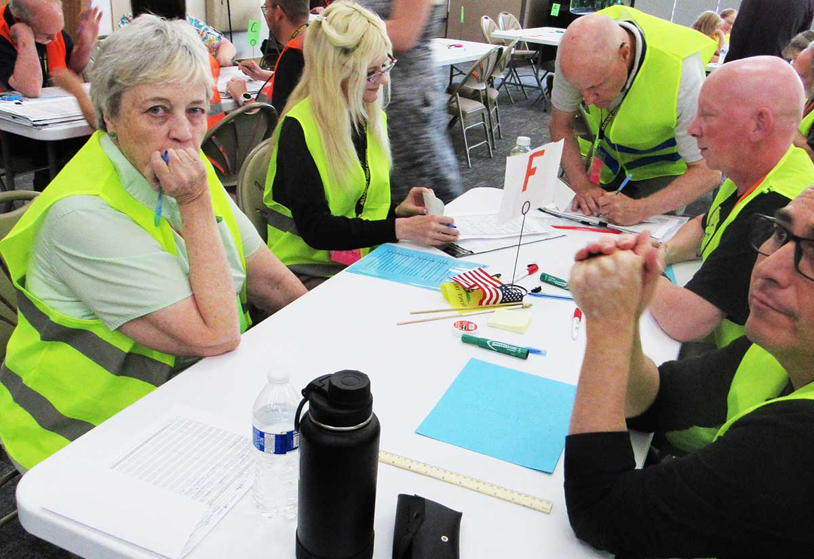
Chain of Custody: Batching to Tallying
Runner checks batching information
Runner signs tally sheets
Runner takes batch to tally station and records tally station information
Tally team checks batching and runner information and accepts the batch
Notes:
If the team is big enough to have a separate runner, the runner brings the batch from the batching area to a particular tally table. With a small team, a batcher or tallier might just move the batch from one pile to another, but still needs to fill in their information as the “runner”.
When picking up a batch, the runner first checks that all batching information is correct and filled out on both tally sheets and the ballot bag. Then the runner signs both tally sheets, delivers the batch to the tally station, and records the tally station number or letter on both tally sheets and the ballot bag. Before taking charge of the batch, the talliers should check that all batching and runner information is recorded.

Slide 8
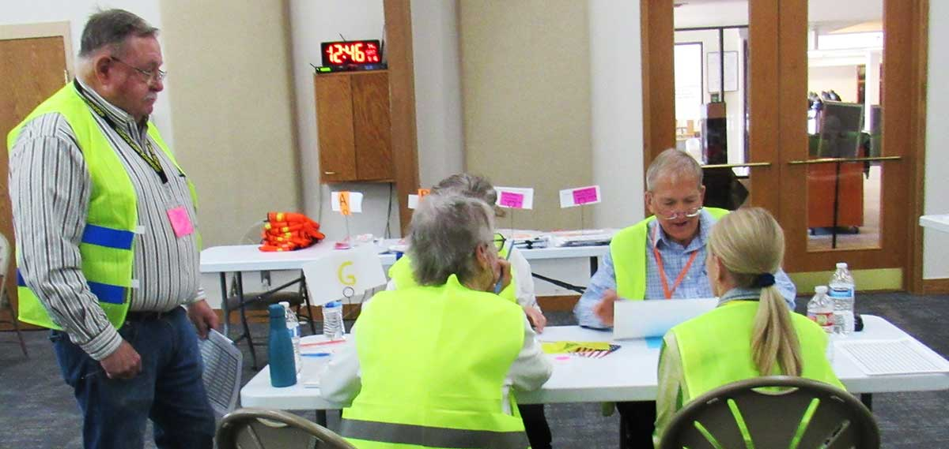
Chain of Custody: Tallying to Aggregation
Runner checks tally information and accepts the batch
Runner signs tally sheets
Runner takes batch to aggregation station and records aggregation station information
Aggregation team checks tally and runner information and accepts the batch
Notes:
If the team is big enough to have a separate runner, the runner brings the batch from a tally table to the aggregation area. Again, for a small team, a batcher or tallier could be the “runner”.
Before moving the batch, the runner first checks that all batching and tally information is correct and filled out on both tally sheets and the ballot bag. Then the runner signs both tally sheets, delivers the batch to the aggregation station, and records the aggregation station number or letter on both tally sheets and the ballot bag. In some cases the batches may just be piled up waiting for aggregation, but if possible, the aggregators should, out of self-defense, check that all the chain of custody information is recorded before accepting the batch. Because if the talliers forgot to put their team identifier on the batch, and their signatures are not very readable, the aggregation team may have to waste time asking “whose signature is this?” before they can record the batch information on the aggregation sheet.

Slide 9
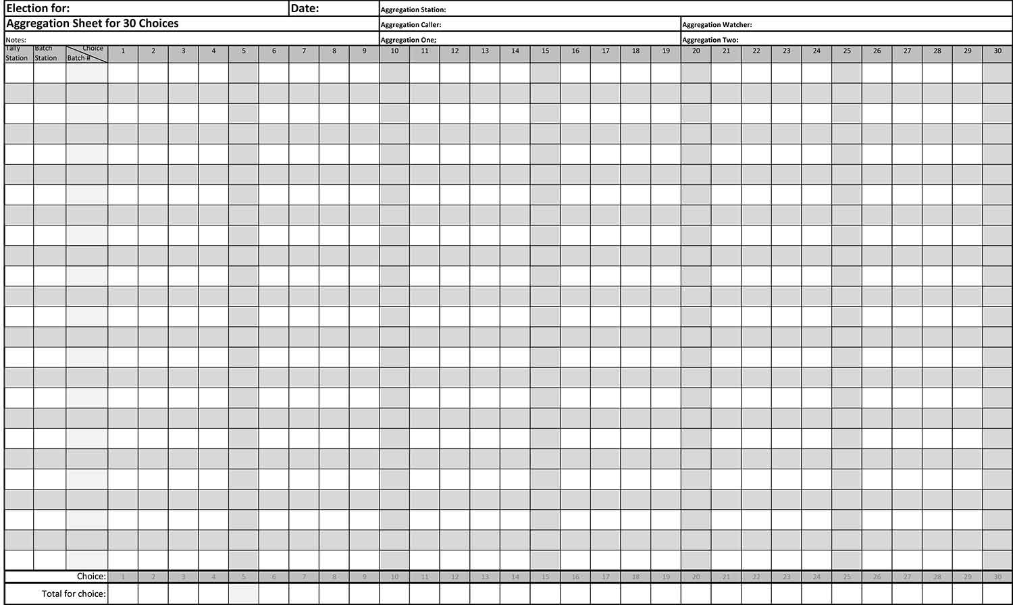
Chain of Custody: Aggregation to Handoff
Aggregation team enters batch information on aggregation sheets
Aggregation team signs completed aggregation sheets
All batches are kept with their tally and aggregation sheets.
Notes:
On the aggregation sheets, each batch’s identifying numbers are recorded on the line with their vote totals, and then the aggregators complete the chain-of-custody record by signing the aggregation sheets. The batches are kept (ideally, sealed in a large tamper-indicating bag) with their own tally sheets and aggregation sheets. Anyone could take the whole pile and follow any batch number back from the aggregation station to the tally and batching station, and know which people handled the batch’s ballots at each point.

Slide 10
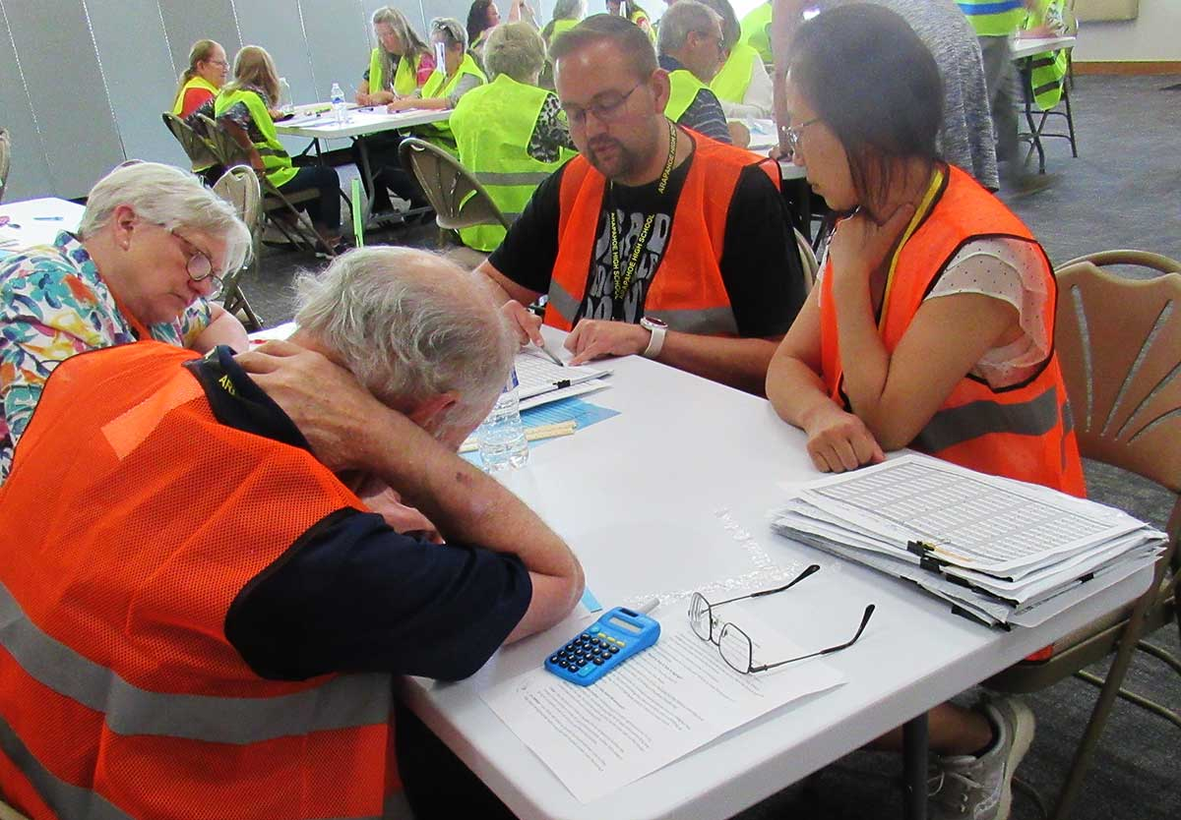
Special Situations
There are special instructions for ballots that can’t or shouldn’t be counted for some reason, ballots with more or fewer votes than a race is allowed, and ballots with write-in candidates.
The point of the special instructions is to clearly distinguish votes that should be counted from those that shouldn’t.
Spoiled ballots
Overvotes
Undervotes
Write-ins
Notes:
The special situations are the 5% of ballots that take 40% of the time. They are rare but important to track, in the same way that balancing your bank account requires accounting for every cent. It’s not that a one-cent difference matters much, but sometimes a one-cent difference is what tips you off to a forgotten credit of $100 and a forgotten purchase of $99.99.

Slide 11
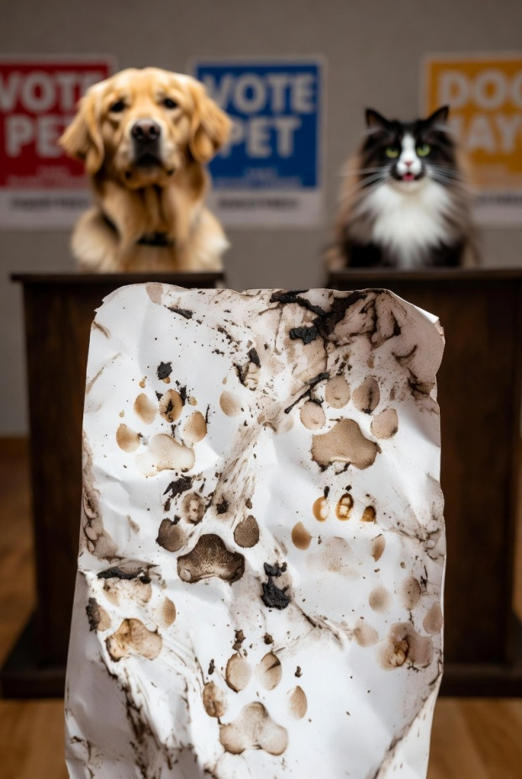
Special Situations: Spoiled Ballots
Usually happens during polling, not counting
Requires tracking as an election record but is not to be counted
If found during counting, put ballot with spoiled ballots received from poll workers, add 1 to total of spoiled ballots, and subtract 1 from all records of the number of ballots in that batch.
Notes:
A ballot gets spoiled when a voter does something wrong (for instance, marks both yes and no) and realizes it before casting the ballot. The voter can trade the spoiled ballot for a new ballot, and the election judges mark or cut the spoiled ballot to make it clear it must not be counted.
A spoiled ballot can also be a ballot so mangled or dirty the voter’s intent can’t be known, or a misprinted ballot. Ballots are usually spoiled while the polls are open and are handled by the election judges, so it should be rare to find a spoiled ballot in the ballot box. But if there is one, it is part of the total number of ballots the hand count leaders signed for, so it must be tracked separately from the counting process so the number of ballots can be reconciled.
If spoiled ballots are found during counting, fill out the spoiled ballot tally sheets, clip the ballots to those tally sheets, move them directly to the aggregation area, and work with the expediter to fix the number of ballots listed for that batch.

Slide 12
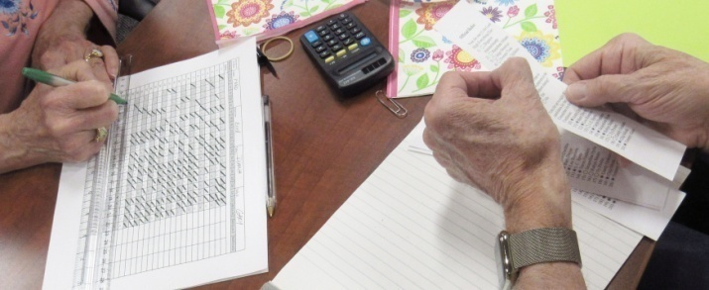
Special Situations: Overvotes
Too many choices marked for a race
No vote in that race should be counted
Ways to handle:
  Batch all overvoted ballots together so talliers pay special attention to that batch, OR
  Tally caller/watcher quickly check the ballots before calling, OR
  Don’t worry about it until it happens
Make one person responsible
Notes:
An overvoted race is a race with too many choices marked. For instance, both “Yes” and “No” are marked, or multiple candidates marked where only one was allowed. In simple races, overvotes can be easy to spot, but races where several candidates are selected (“choose 5 of 8”) may require extra attention.
None of the votes in the overvoted race count, because it is impossible to know which the voter actually intended, but other races on the ballot should still be counted.
In some cases (such as many selections allowed in one race) it may make most sense to have batchers watch for overvotes; in other cases (needing to get batching underway quickly) tally callers and watchers may be best for paying attention to overvotes. In extreme cases (such as “choose 25 out of 75”), assign a separate team to check for and separate overvoted ballots before batching. Make sure the responsibility is specifically assigned to one person, but instruct the others on how they should alert talliers if they notice an overvote.
One way to focus attention on overvoted ballots is to make separate batch(es) of those ballots during batching.

Slide 13
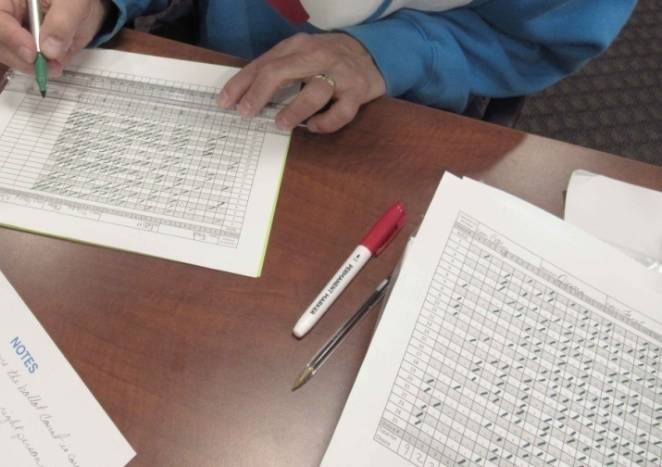
Special Situations: Undervotes
Voter marked fewer choices than allowed
OK, but creates easy fraud target
Ways to handle:
  Just leave the choice blank
  Underline the choice to show it is deliberately blank
  Explanatory mark beside that line
  Tally sheet with “undervote” column
Notes:
An undervote is a race where the voter marked fewer choices than allowed, or none at all. There is nothing wrong with an undervote, but it can be an easy target for fraudulent marks on the ballot before the vote is counted.
There may be no need to do anything different for an undervote – just don’t record the non-vote – but marking the available choices in some way such as a line underneath will prevent someone from fraudulently filling in a choice. If a whole ballot is blank, making a mark off to the side of that line (such as “BB” for “blank ballot”) keeps talliers from accidentally filling in the line with the next ballot’s choices.
To clearly and completely show every vote and undervote, a tally sheet can have an extra column for marking undervotes; this will take extra time but allows the extra check of reconciling all votes in the batch before it moves to aggregation. For instance, if a batch has 25 ballots and a voter can mark up to 20 choices per ballot, then the totals across the bottom, including the number of undervotes, must add up to 500. But not all elections require this level of detail.

Slide 14
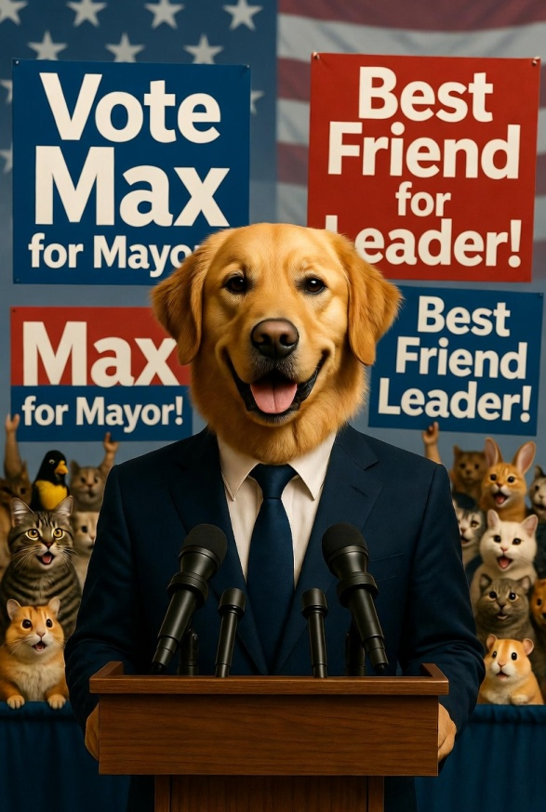
Special Situations: Write-Ins
Colorado allows very limited write-ins
Write-ins get extra columns
  Possibly on separate page
Marked like other votes, just with a name instead of a number at the top of the column
Improper write-ins are overvotes
Notes:
In Colorado, write-in votes are not always allowed, and where allowed they are usually limited to officially announced write-in campaigns. So there should be no need to count votes for Mickey Mouse and Donald Duck. If a race allows write-ins, leave space for write-ins at the end of the tally and aggregation sheet, or staple a separate page for write-ins to the tally and aggregation sheets.
A ballot with a write-in not on the list of approved write-in candidates should be treated as an overvote for that race.

Slide 15
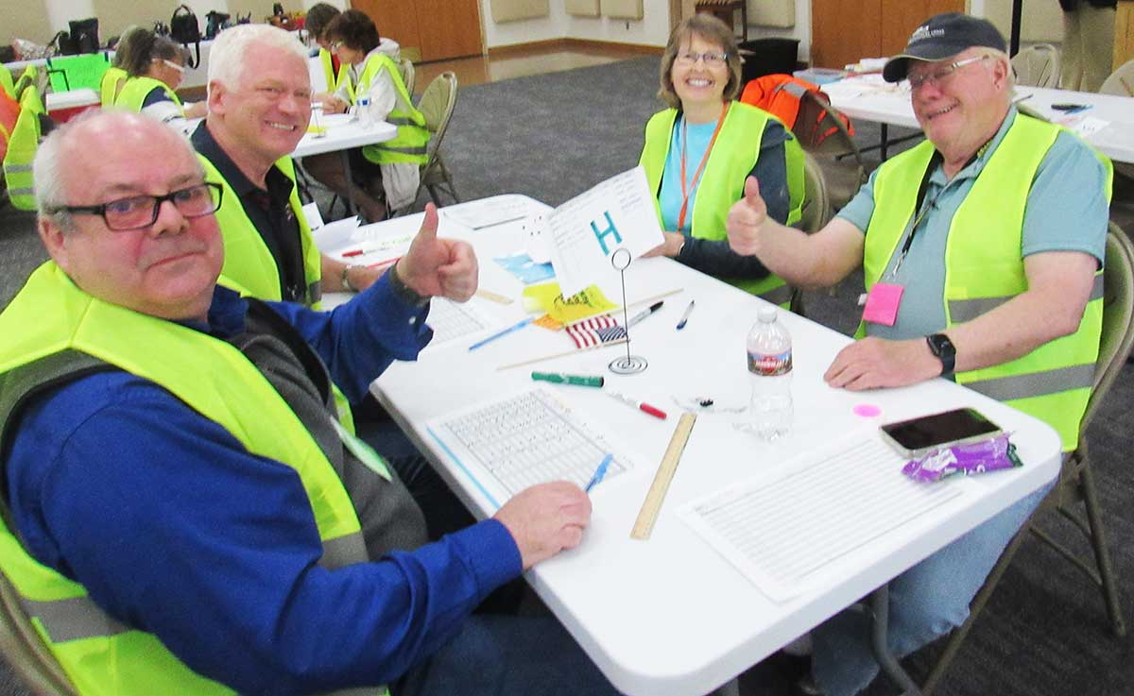
Reconciliation
Handover at close of polls
Reconciliation after batching
Spoiled ballots
Final reconciliation
Handoff
Notes:
Reconciliation shows that no ballots were added or subtracted during the process. The number of ballots as reported by the poll workers gets compared against the count from batching, and gets compared again to the aggregated results at the end. This is like a bank teller counting your money in front of you so both sides agree on the numbers before the valuables are handed over.

Slide 16
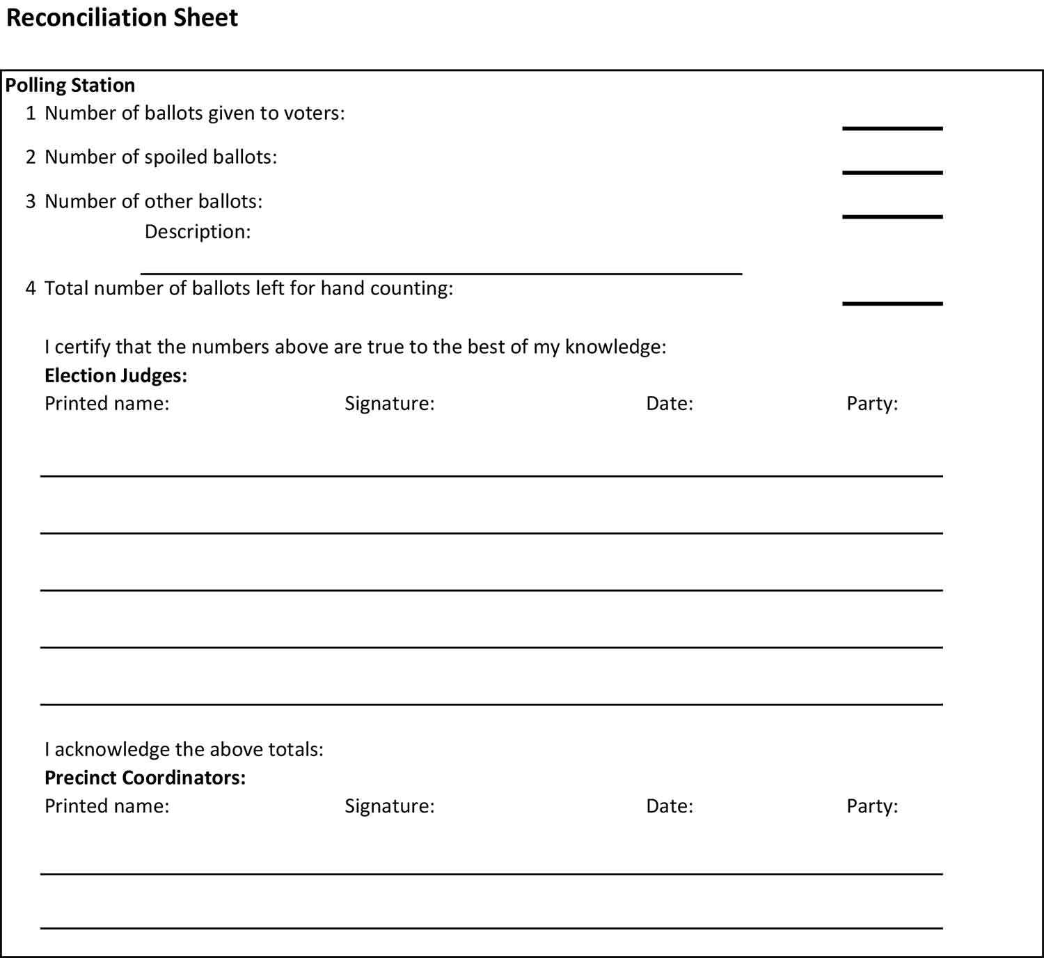
Reconciliation: Handover (Close of Polls)
After polls close, poll workers record number of:
  Ballots given to voters
  Spoiled ballots
  Other ballots (needs explanation!)
  Total number of ballots to be hand counted
Hand count leaders sign reconciliation sheet to acknowledge the reported totals
Signature does not indicate agreement with totals
  You haven’t counted for yourself yet!
Notes:
Election Judges should account for and return blank ballots to the county; the hand count team should not normally have to count blank ballots.
The number of ballots given to voters minus the number of spoiled ballots ought to equal the number of ballots in the ballot box(es). There could be minor discrepancies if for instance a voter decided not to vote and left with a ballot. Election Judges should be able to account for any discrepancies.
Hand counters are only accepting responsibility for the ballots listed as available for hand counting, plus the responsibility to deliver the listed spoiled ballots.

Slide 17
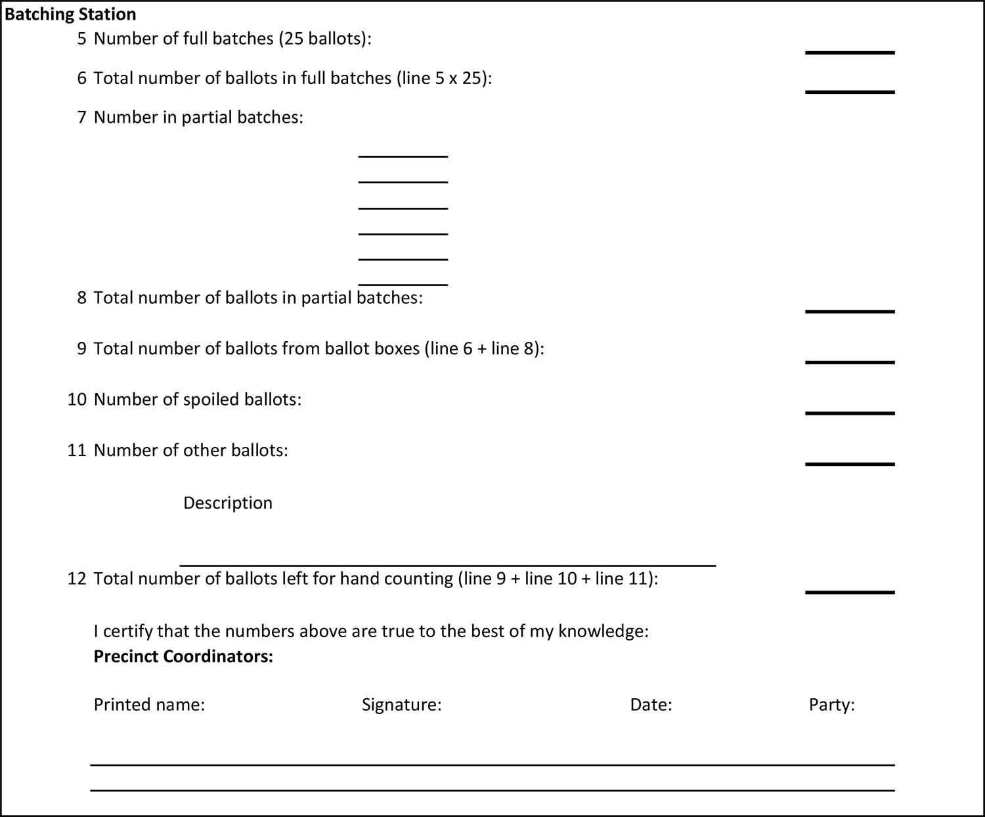
Reconciliation: After Batching
On the reconciliation forms, record:
  Number of full batches
  Total number of ballots in full batches
  Number in partial batches
  Total number of ballots in partial batches
  Total number of ballots from ballot boxes
  Number of spoiled ballots
  Number of other ballots
  Total number of ballots left for hand counting
Notes:
Batching is the authoritative count of the ballots (as opposed to tallying, or tabulating, which is the authoritative count of the votes.) So after batching you already have all the numbers you need to compare with the totals handed over from the poll workers, but these totals will also be compared with the totals as recorded at aggregation. Ideally, the totals will match perfectly each time. If not, you are not necessarily responsible for a mismatch between the poll workers’ total ballots and the ones you have just counted, but if there is a discrepancy you need to try to figure out why.
Specifically, if the total number of ballots left for hand counting by poll workers does not equal the total number of ballots hand counted at batching, try to find the reason for any discrepancy. If the discrepancy cannot be resolved, refer to election law to decide whether the discrepancy is small enough the team can move on to the next step.

Slide 18
Reconciliation: Spoiled Ballots
Votes are not counted on spoiled ballots, but the ballots themselves are part of the total ballots the hand count team has custody of
Spoiled ballots found during counting get their own tally sheet and go straight to the aggregation area
Spoiled ballots from poll workers are kept separate during the counting and added to the total at the end.
Notes:
Spoiled ballots are a separate count because though they do not contribute to the vote results, the hand count team has custody of them between the close of the polls and delivering the counted ballots to election officials.

Slide 19
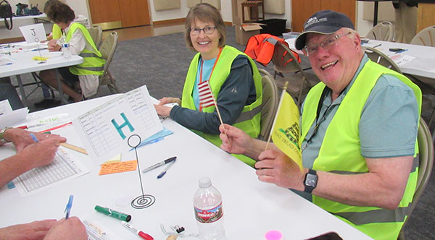
Reconciliation: Final Reconciliation
Record on the reconciliation forms:
  Total number of ballots from ballot boxes
  Number of spoiled ballots
  Number of other ballots
  Total number of ballots left for hand counting
If the numbers reconcile, sign the sheet to agree to the number of ballots counted in hand counting
Notes:
If the total number of ballots left for hand counting by poll workers, or the number counted in batching, do not equal the total number of ballots at this point, try to find the reason for any discrepancy. Refer to election law to decide whether the discrepancy is small enough the team can move on to the next step.

Slide 20
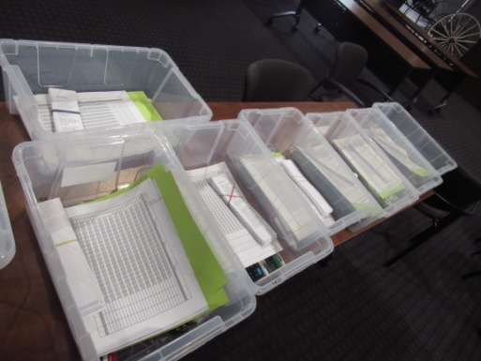
Reconciliation: Handoff
After results are posted at the polling place, and then called in to the next level, the package of ballots can be turned over to the election officials according to city/county procedures.
Officials sign the reconciliation form in the presence of the hand count leaders.
Notes:
Once the results have been tabulated, aggregated, and posted, the situation is less urgent, because the hand count team has succeeded in protecting the ballots until their results can be extracted. Fraudulent treatment of tabulated ballots is much harder to hide.
Hand count leaders must continue to guard the ballots until signed over to election officials according to local procedures. The hand count is not done until the paperwork is done!

Slide 21
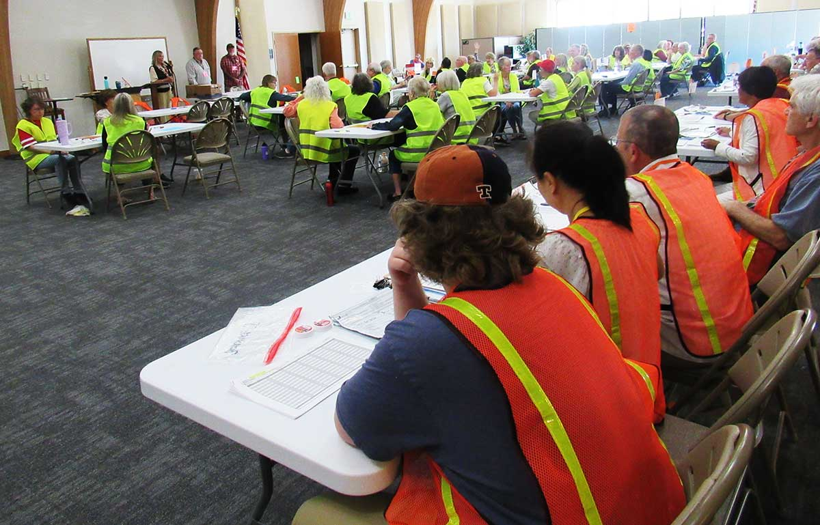
The End!
You are no longer just a participant; you now know enough to be a leader.
Pass it on – duplicate yourself – multiply the effort – TEACH!
Continuing education:
Cause of America Elections 101 short videos https://rumble.com/user/CauseofAmerica/videos
Hand Count Road Show https://handcountroadshow.org/
Fingerprintsoffraudthemovie.com
Colorado Revised Statutes (Title 1 is the part about elections) https://content.leg.colorado.gov/agencies/office-legislative-legal-services/colorado-revised-statutes

